Slide 1



iot data analytics project
mETA-LEARNING
Student Leonardo falanga
MAT. [0522502019]
pROF.SSA lOREDANA CARUCCIO

Slide 2



Introduction
What is Deep Learning?
Deep learning is a subset of machine learning that utilizes neural networks with multiple layers to analyze and learn from large datasets. It enables computers to perform complex tasks like image recognition, natural language processing, and autonomous decision-making by mimicking the way human brains process information.
Over the past decade, deep learning has transformed various industries, including healthcare, finance, and robotics. Advances in computational power and the availability of large datasets have accelerated its adoption. The ability of deep learning to detect patterns and improve over time makes it an essential tool in the future of artificial intelligence.

Slide 3





What is meta-learning
Meta-learning meaning
Meta-learning, also known as “learning to learn”, is an approach where a model learns how to choose or optimize other models based on the data.
Understanding the project
So what does the meta-model do?
It does not classify the ECG directly.
Instead, it selects the best model to classify the data, based on the extracted features of that ECG segment.
It’s like a model that learns to delegate the task to the right expert.
Why is this useful?
Automates model selection process
Adapts to different types of data (patients, sensors, environments)
Improves robustness and efficiency of real-world systems

Slide 4
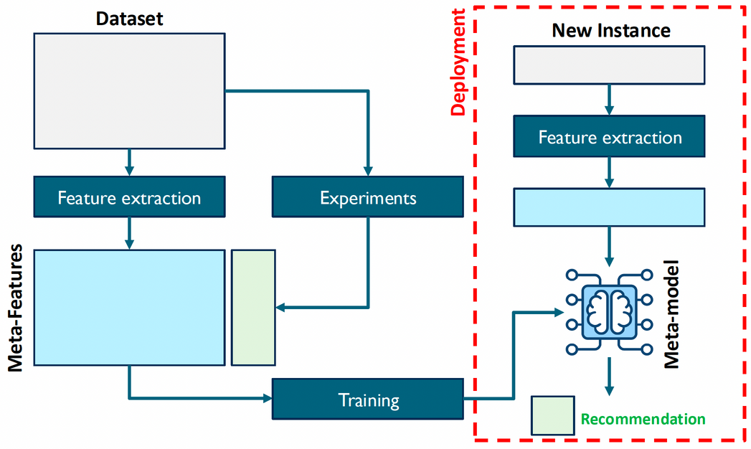
GOALS
Construct a meta-classifier to select the best anomaly detection algorithm on ECG time series
Use blocks of ECG signals as time series
Extract descriptive features from each block
Compare KNN and Isolation Forest
Train a predictive meta-model

Slide 5
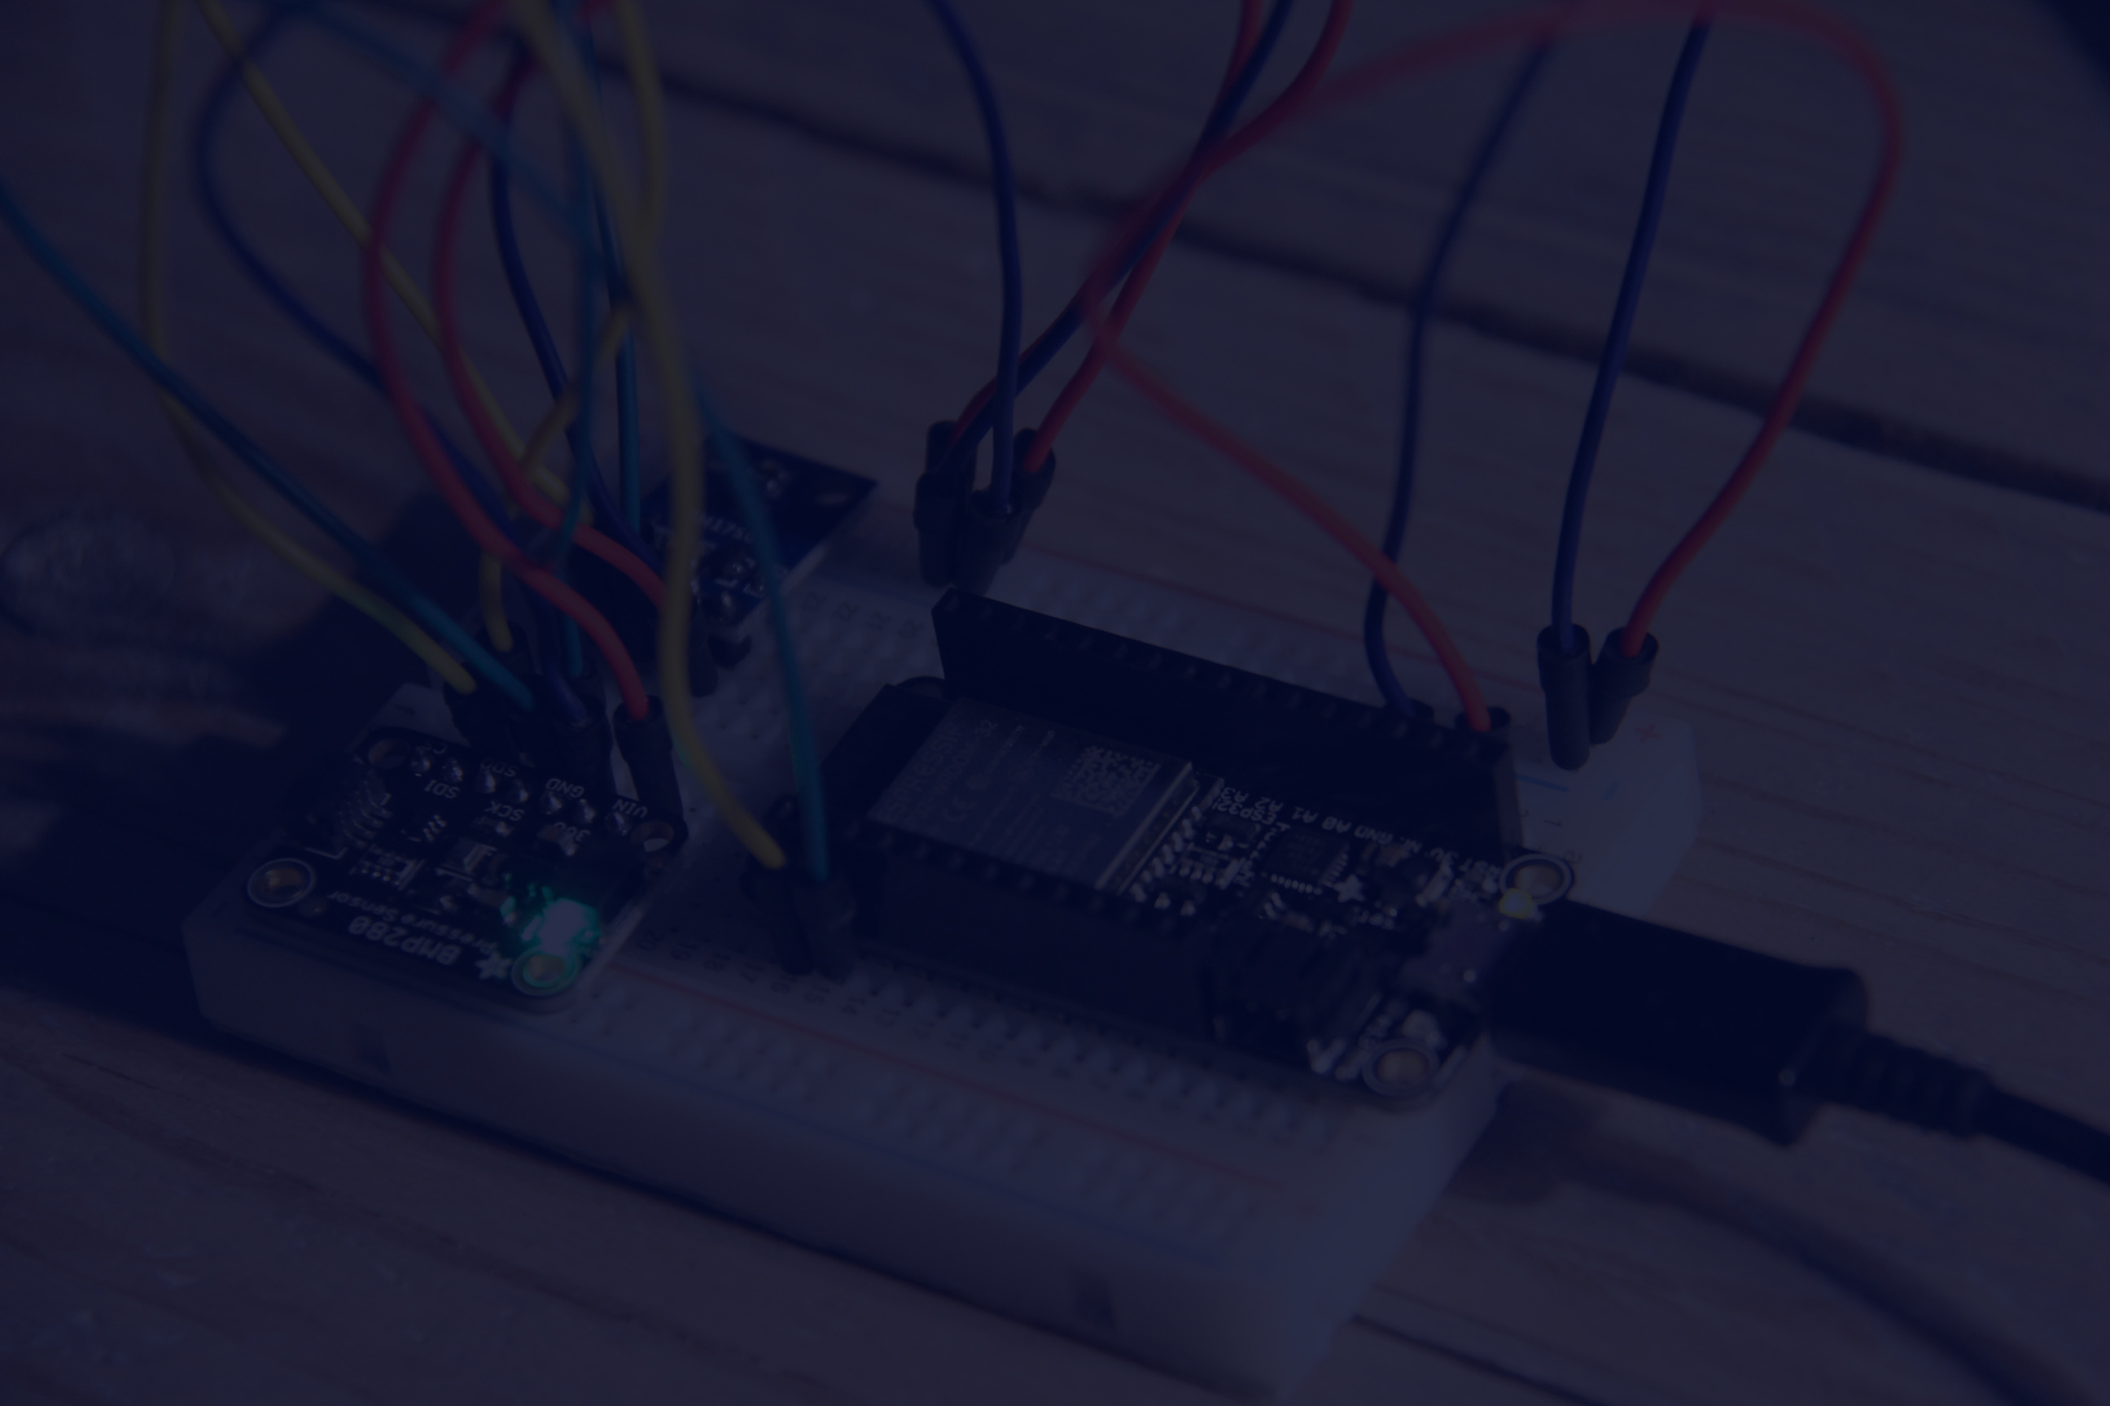
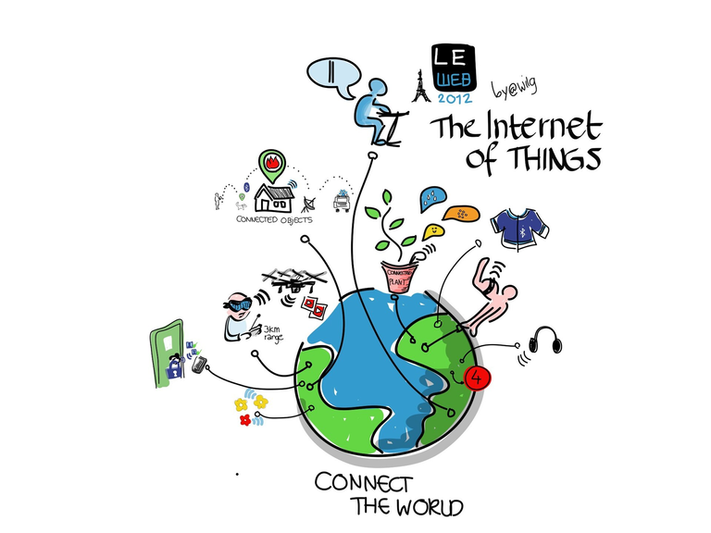
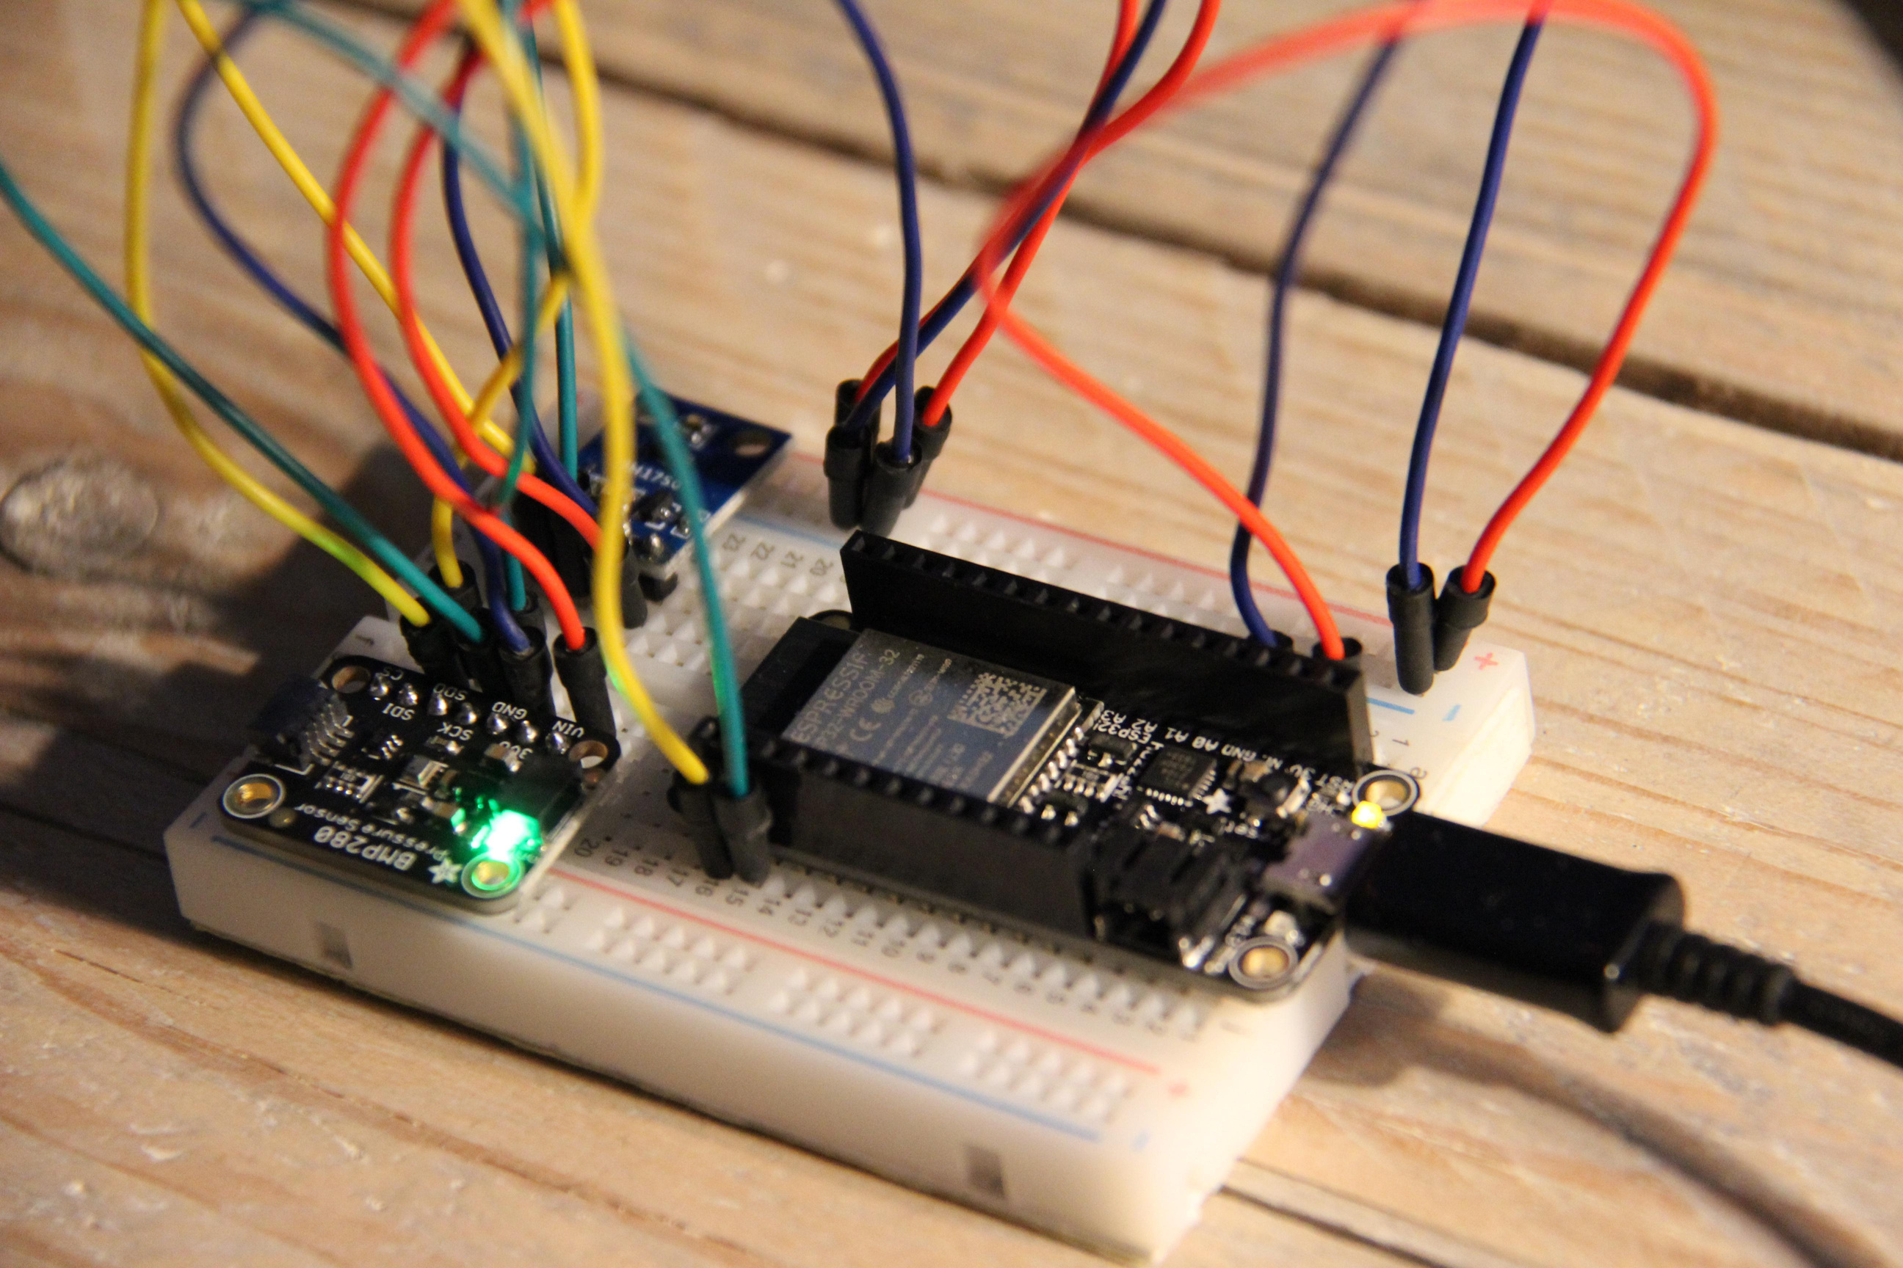
Future with AIfES
Artificial Intelligence for Embedded Systems
Photo from IoT Wikipedia page
I can apply this logic to embedded systems, using AIfES:
Run the meta-model on microcontrollers
Use lightweight models (e.g., decision trees or neural nets) to select the best model dynamically
Very useful for IoT, Edge AI, and wearable medical devices
This work considers future deployment on embedded systems using AIfES, a C-based machine learning library developed by the Fraunhofer Institute for Microelectronic Circuits and Systems (IMS). AIfES is subject to proprietary licensing.

Slide 6

-Real ECGs divided into blocks of 2000 rows:
-Each block becomes a self-contained time series
-Feature extraction with TSFRESH (EfficientFCParameters)
-Meta-dataset creation with feature + best model
🧪 Dataset e Preprocessing

Slide 7

-Anomaly detection models evaluated on each block:
-KNN - K-Nearest Neighbors (unsupervised)
-Isolation Forest - based on random trees
-Random Forest as the final meta-classifier
🧠 Algorithms Considered

Slide 8


✅ Results and Conclusions
The meta-model achieved an accuracy of 90.80% on the test set. Despite the high score, the confusion matrix reveals a tendency to favor K-Nearest Neighbors (KNN) over Isolation Forest.
This highlights a potential class imbalance or lack of informative meta-features distinguishing between the two base models.
The train/test split ensures realistic performance evaluation.
The system demonstrates partial generalization in model selection, especially favoring KNN.
Inference remains efficient, even on short signal blocks (2000 samples).

Slide 9
Future Work
Possible improvements and developments:
better feature engineering or class balancing to improve generalization
Applying aifes
test on mcus

Slide 10
Thank You

